Slide 1
SkillsBridge
An AI-Powered Job Readiness Platform
Problem in Current Job Market
Candidates apply blindly without understanding skill requirements
Employers struggle to find “job-ready” candidates
Lack of personalized guidance on what to learn to crack specific jobs
Mismatch between academic knowledge and industry expectations
Our Solution
Smart Job Matching using Skill Vector Mapping AI-Based Skill Gap Detection Personalized Upskilling Recommendations (Courses, Certifications) Assessment & Mock Interview using AI (LLaMA + Gemini) Goal – Transform Applicants into Job-Ready Professionals

Slide 2
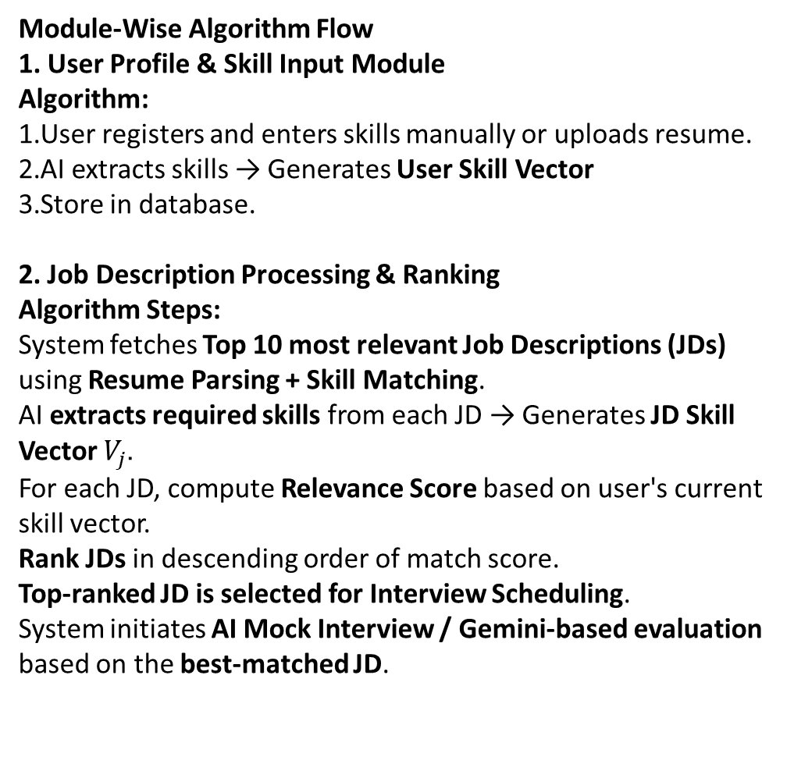
3. Upskilling Recommendation Module
Algorithm:
1. Detect missing skills from Gap Vector.
2. Search Course DB / AI Suggestion (LLaMA) to fetch learning content.
3. Generate a Personalized Learning Path with priority-wise skills.
4. Show Recommended Learning Timeline + Progress Tracking.
5. Assessment & AI Interview Module
Algorithm:
1. Schedule Mock Interview with AI once learning progress reaches threshold.
2. AI generates role-based interview questions from top-matched JD.
3. AI evaluates answers and provides real-time feedback & improvement tips.
4. System updates readiness score and suggests retry or move to job application.
Module-Wise Algorithm Flow
1. User Profile & Skill Input Module
Algorithm:
User registers and enters skills manually or uploads resume.
AI extracts skills → Generates User Skill Vector
Store in database.
2. Job Description Processing & Ranking
Algorithm Steps:
System fetches Top 10 most relevant Job Descriptions (JDs) using Resume Parsing + Skill Matching.
AI extracts required skills from each JD → Generates JD Skill Vector $V_{j}$.
For each JD, compute Relevance Score based on user's current skill vector.
Rank JDs in descending order of match score.
Top-ranked JD is selected for Interview Scheduling.
System initiates AI Mock Interview / Gemini-based evaluation based on the best-matched JD.

Slide 3
Test Cases
S.No | Module | Input | Expected Output
1 | User Registration | New user signs up with email/password | Account created successfully
2 | Resume Upload | Upload resume file (PDF/DOC) | Resume parsed successfully
3 | Skill Entry | User enters skills manually | Skills saved automatically after cleaning & preprocessing
4 | Job Search | User searches for jobs | Top 10 relevant job listings displayed automatically
5 | Job Recommendation | User profile and skills | Platform suggests suitable jobs automatically
6 | Upskilling Suggestion | Partial match with job requirements | Recommended courses/resources shown
7 | Learning Path Display | User selects suggested courses | Personalized learning timeline displayed
8 | Assessment Attempt | User completes a test/quiz | Test submitted and score shown
9 | Mock Interview | User schedules AI mock interview | Interview conducted and feedback provided
10 | Progress Tracking | User completes learning modules | Progress status updated

Slide 4
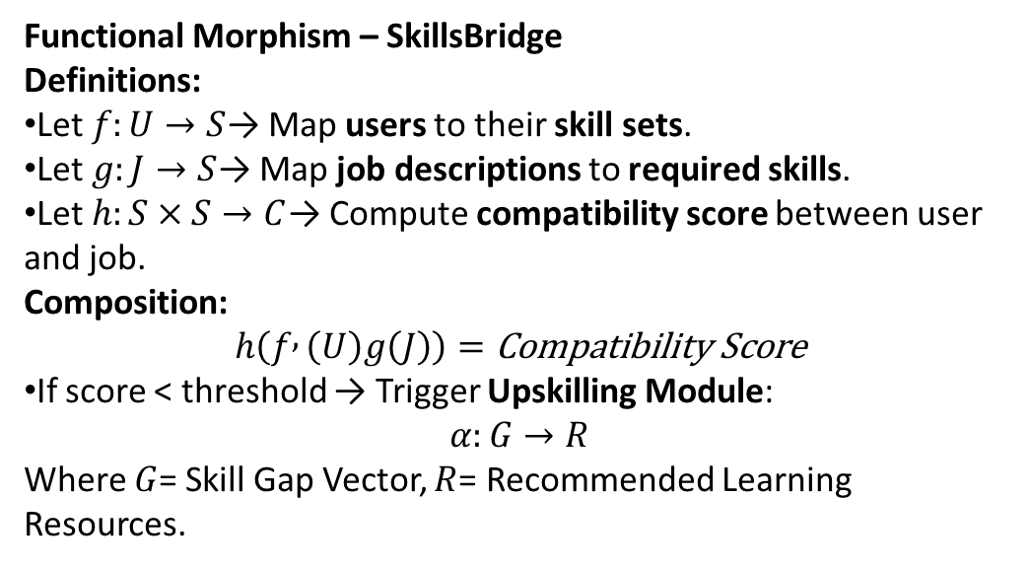
Functional morphism
Functional Morphism – SkillsBridge
Definitions:
Let $f:U→S$→ Map users to their skill sets.
Let $g:J→S$→ Map job descriptions to required skills.
Let $h:S×S→C$→ Compute compatibility score between user and job.
Composition:
$$h\left(f , \left(U\right)g\left(J\right)\right)=\text{Compatibility} \text{Score}$$
If score < threshold → Trigger Upskilling Module:
$$α:G→R$$
Where $G$= Skill Gap Vector, $R$= Recommended Learning Resources.

Slide 5
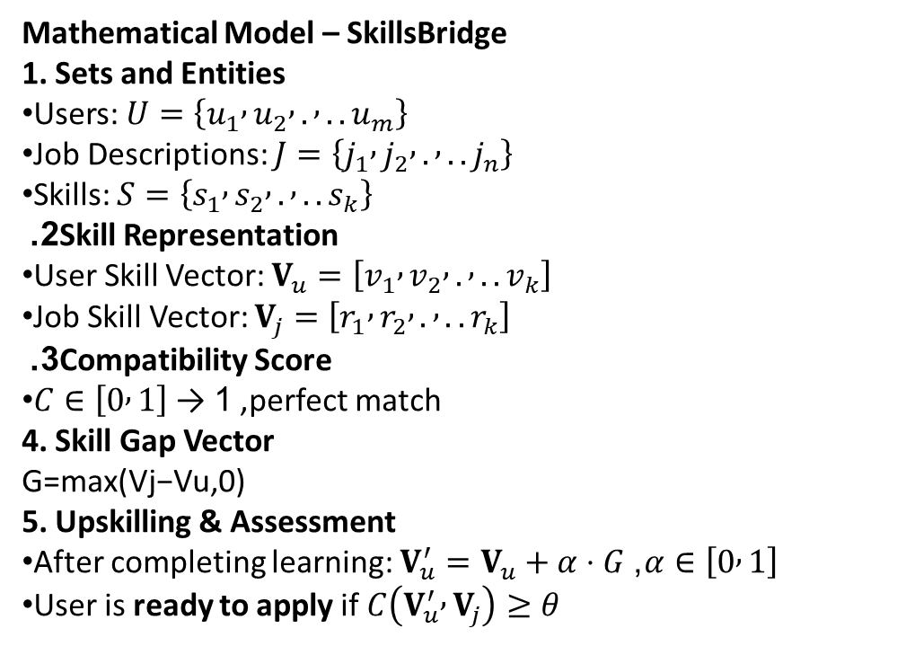
Mathematical model
Mathematical Model – SkillsBridge
1. Sets and Entities
Users: $U=\left\{u_{1} , u_{2} , . , ..u_{m}\right\}$
Job Descriptions: $J=\left\{j_{1} , j_{2} , . , ..j_{n}\right\}$
Skills: $S=\left\{s_{1} , s_{2} , . , ..s_{k}\right\}$
2. Skill Representation
User Skill Vector: $V_{u}=\left[v_{1} , v_{2} , . , ..v_{k}\right]$
Job Skill Vector: $V_{j}=\left[r_{1} , r_{2} , . , ..r_{k}\right]$
3. Compatibility Score
$C∈\left[0 , 1\right]$, 1 → perfect match
4. Skill Gap Vector
G=max(Vj​−Vu​,0)
5. Upskilling & Assessment
After completing learning: $V_{u}^{′}=V_{u}+α⋅G$, $α∈\left[0 , 1\right]$
User is ready to apply if $C\left(V_{u}^{′} , V_{j}\right)≥θ$

Slide 6
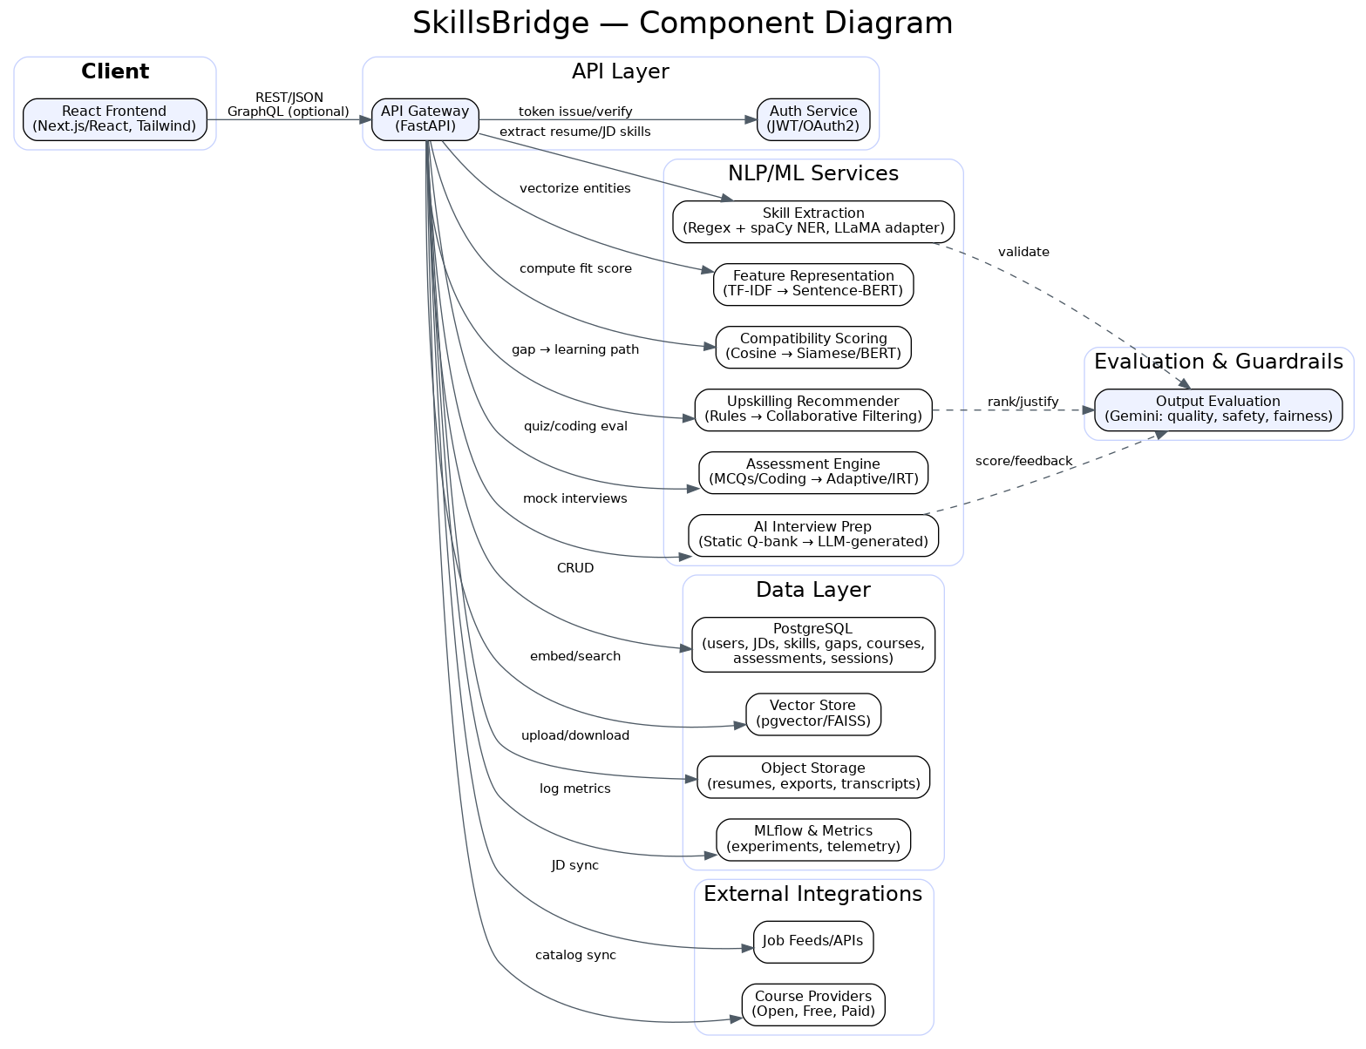
UML Diagram

